Slide 1
Machine Learning
Lecture 6: LR Model with Regularizations
Dr. Beilun Wang
Southeast University
School of Computer Science
and Engineering

Slide 2


Roadmap

Slide 3
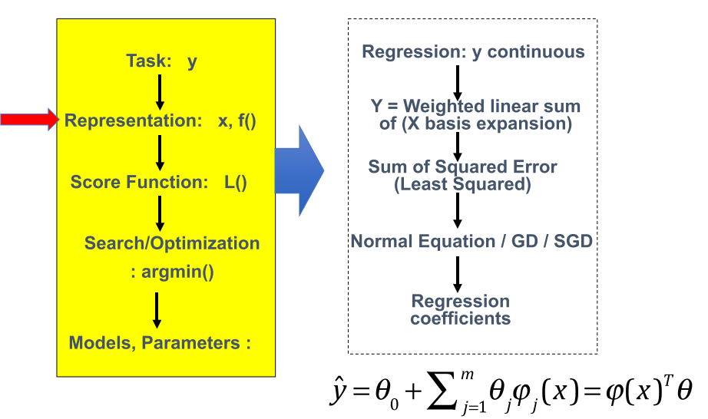
Last: Multivariate Linear Regression with basis Expansion

Slide 4
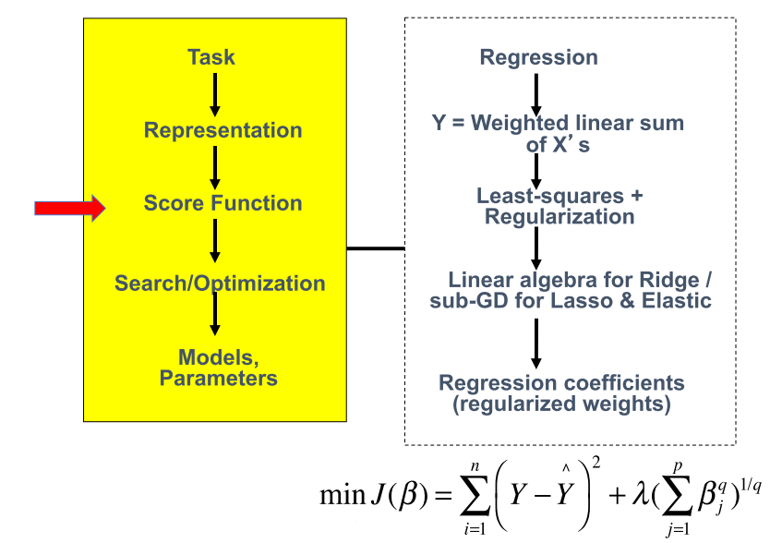
Today: Regularized multivariate linear regression

Slide 5
We aim to make the learned model
• Generalize Well
• Computational Scalable and Efficient
• Robust / Trustworthy / Interpretable
• Especially for some domains, this is about trust!

Slide 6
Today
Review: (Ordinary) Least squares: squared loss (Normal Equation)
Ridge regression: squared loss with L2 regularization
Lasso regression: squared loss with L1 regularization
Elastic regression: squared loss with L1 and L2 regularization
How to Choose Regularization Parameter

Slide 7
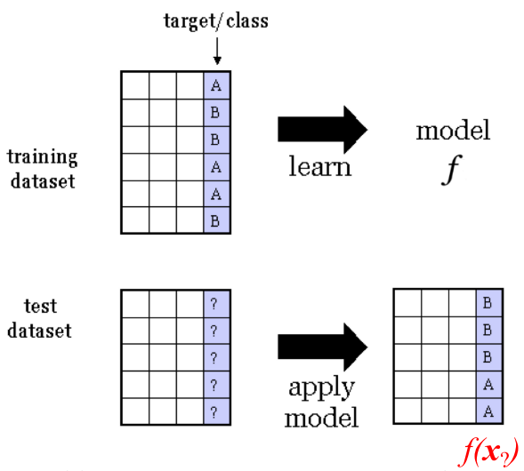
Supervised Regression
Training dataset consists of input-output pairs
When, target Y is a continuous target variable

Slide 8
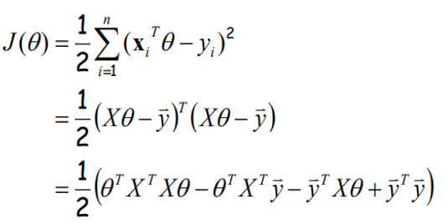
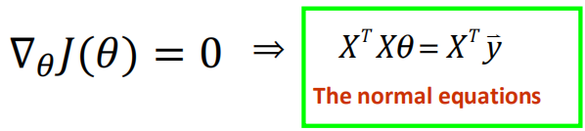

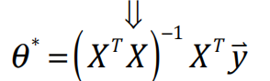
Review: Normal equation for LR
Write the cost function in matrix form:
To minimize $J\left(θ\right),$ take derivative and set to zero:
Assume that X^{T}X is invertible
Closed form
solution

Slide 9
Comments on the normal equation
What if X has less than full column rank?
→ Not Invertible

Slide 10
Today
Review: (Ordinary) Least squares: squared loss (Normal Equation
Ridge regression: squared loss with L2 regularization
Lasso regression: squared loss with L1 regularization
Elastic regression: squared loss with L1 and L2 regularization
How to Choose Regularization Parameter

Slide 11
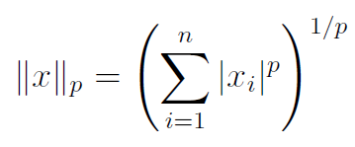
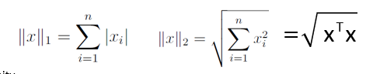
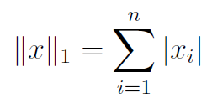
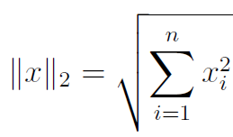
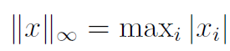
Review: Vector norms
​
A norm of a vector ||x|| is informally a measure of the “length” of the vector.
Common norms: L₁, L₂ (Euclidean)
L_{infinity}

Slide 12
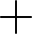
Review: Vector norms
Vector Norm
(L2, when p=2)

Slide 13
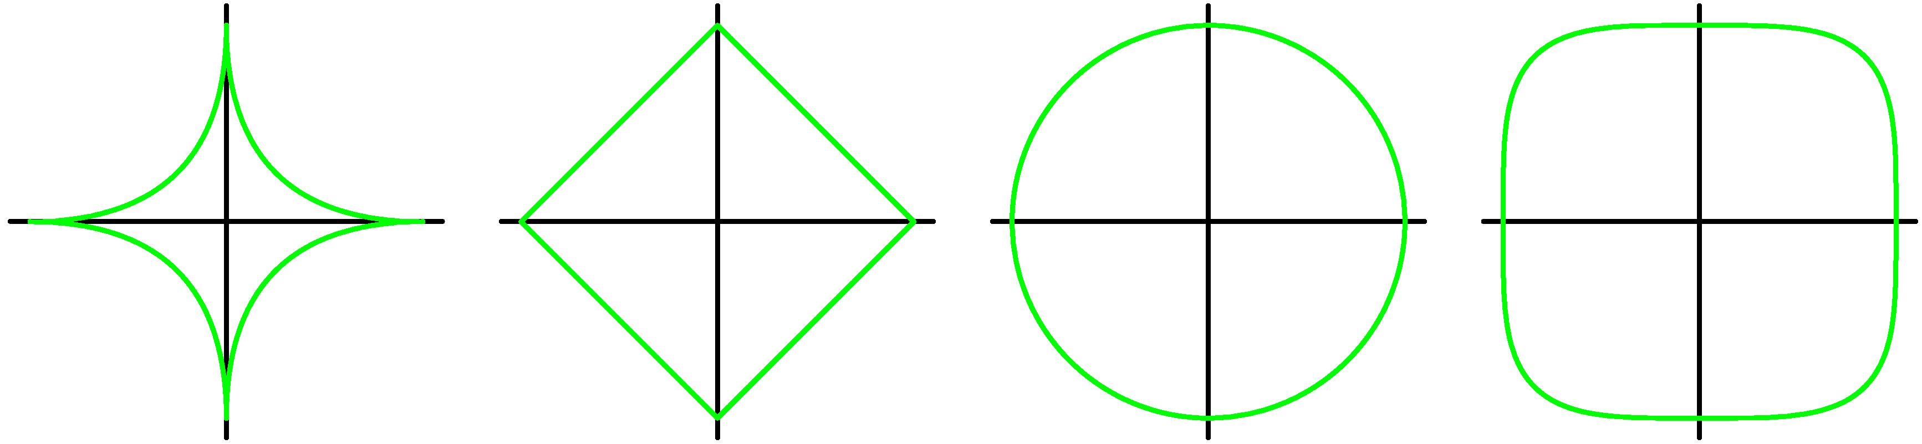
Review: Vector norms
p - Norms
p = 0.5
p = 1
p = 2
p = 4

Slide 14
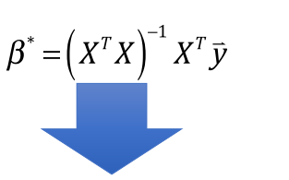
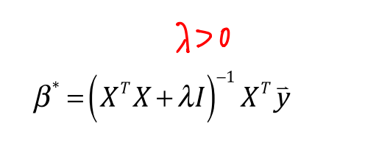
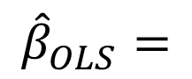
Ridge Regression / L2 Regularization
If not invertible, a classical solution is to add a small positive element to diagonal
$${\hat{β}}_{OLS}=$$

Slide 15
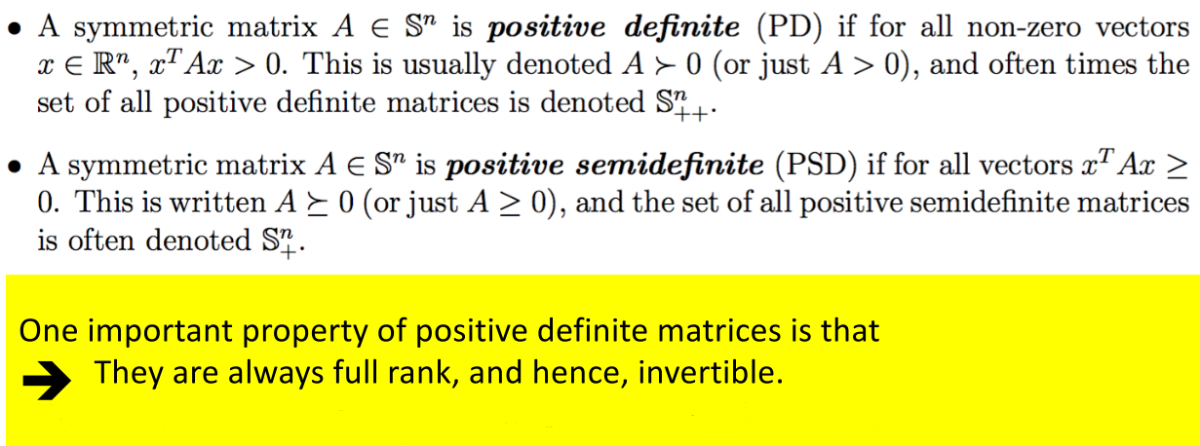
Extra: Positive Definite Matrix

Slide 16
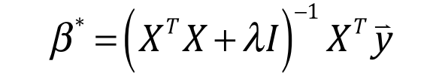
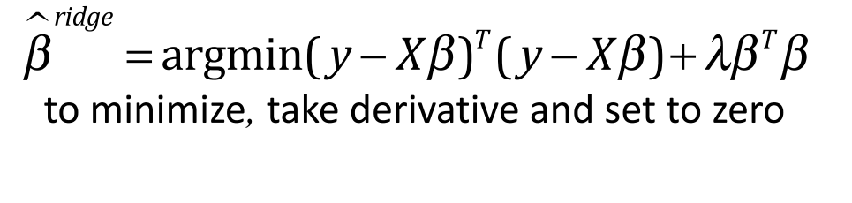
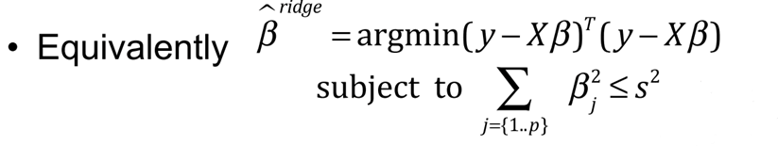
Ridge Regression / Squared Loss+L2
As the solution from

Slide 17
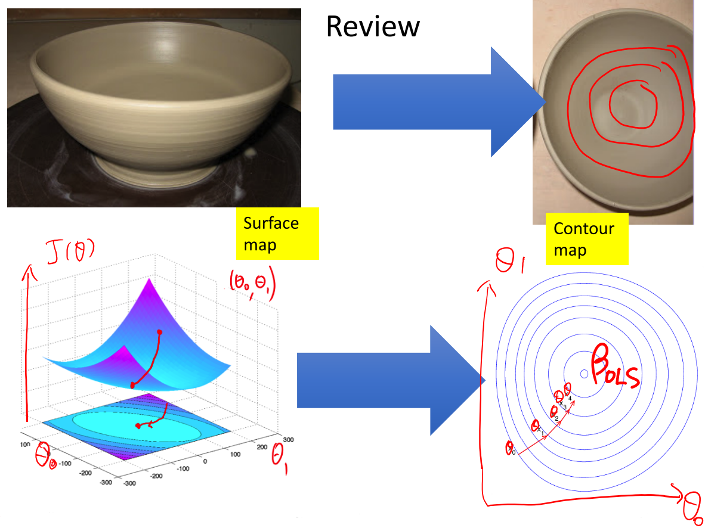
Ridge Regression / Squared Loss+L2

Slide 18
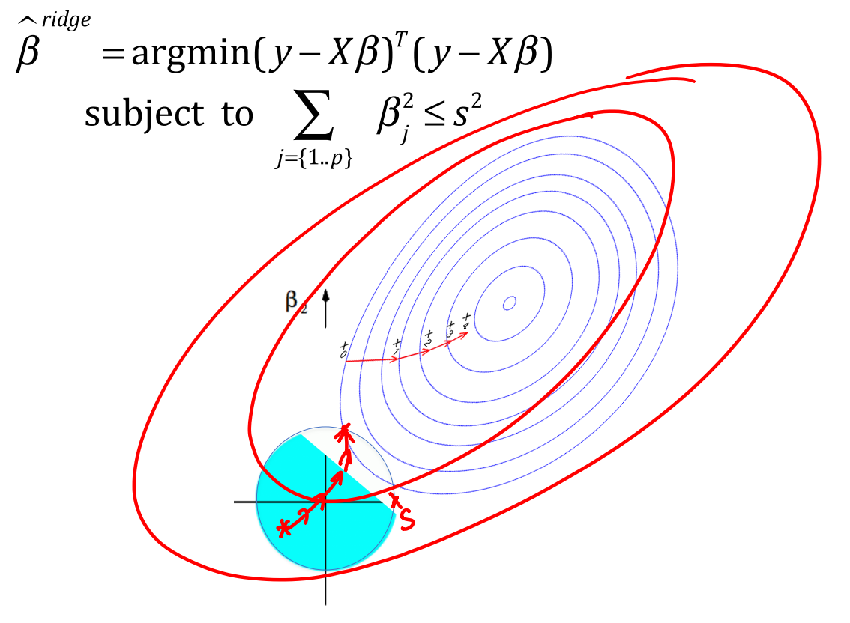
Ridge Regression / Squared Loss+L2

Slide 19
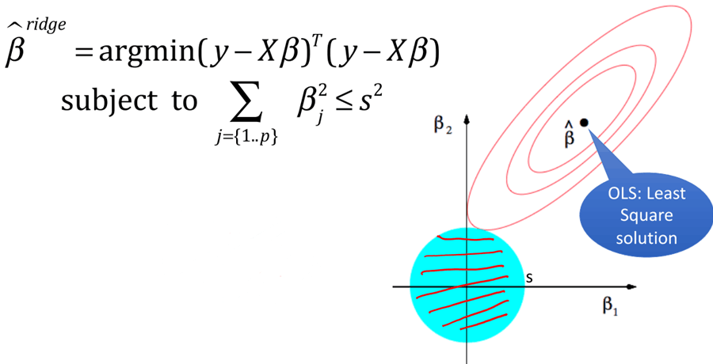
Objective Function’s Contour lines from Ridge Regression
circle with radial s

Slide 20
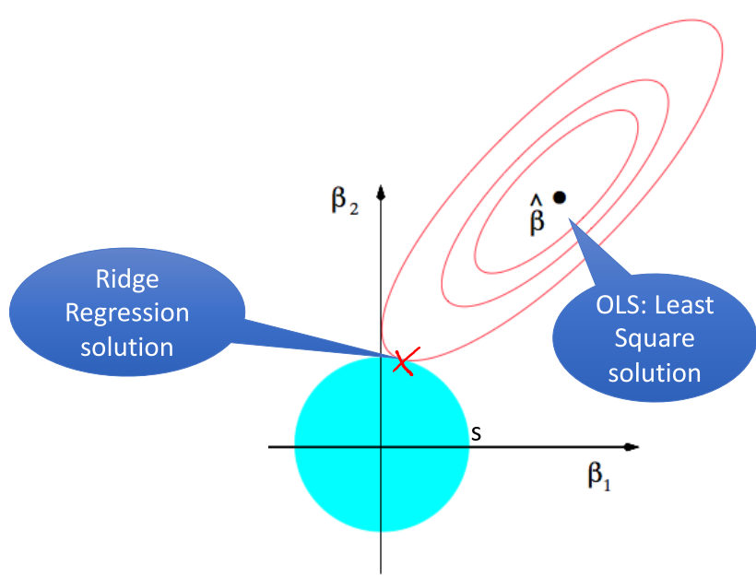
Objective Function’s Contour lines from Ridge Regression

Slide 21
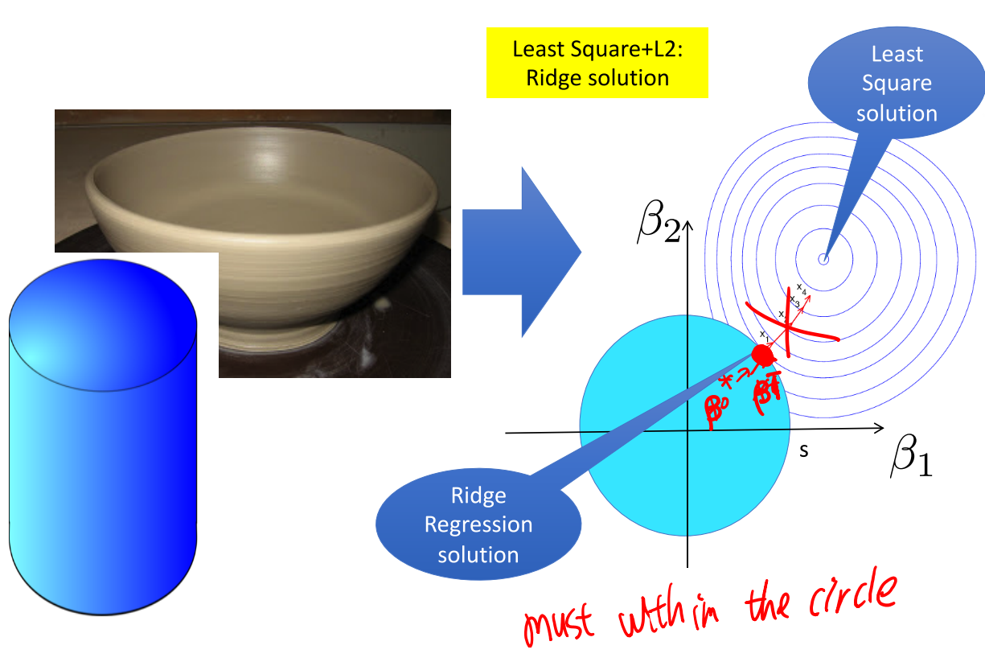
Least Square+L2: Ridge solution

Slide 22
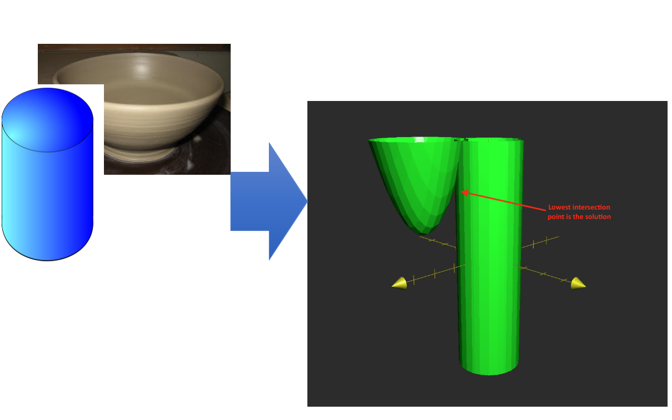
Least Square+L2: Ridge solution

Slide 23
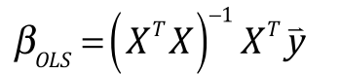
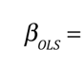
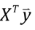
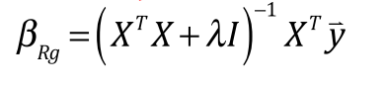
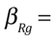
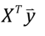
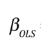
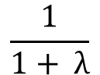
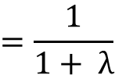
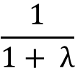
Parameter Shrinkage
when X^{T}X=I
when X^{T}X=I
$$\frac{1}{1+ λ}$$
$$=\frac{1}{1+ λ}$$
When
$$\frac{1}{1+ λ}$$
X^{T}X=I
shrinkage
more general case , see advanced analysis @ Page65 of ESL book @ http://statweb.stanford.edu/~tibs/ElemStatLearn/printings /ESLII_print10.pdf

Slide 24
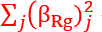
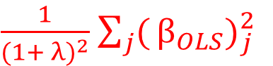
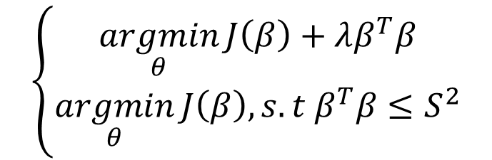
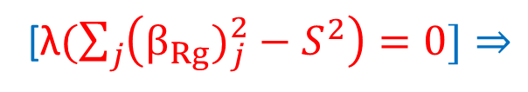
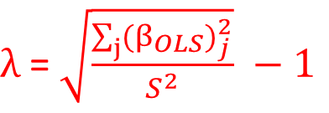
Extra: two forms of Ridge Regression
$$\left\{\begin{aligned}\underset{θ}{argmin}{J\left(β\right)+λβ^{T}β} \\ \underset{θ}{argmin}{J\left(β\right), s.t β^{T}β≤S^{2}}\end{aligned}\right.$$
Totally equivalent
Optimized Solution $β_{Rg}^{∗}$ needs λ > 0 (necessary condition)
[λ$(\sum_{j}{\left(β_{Rg})_{j}^{2}−S^{2}\right)=0]}⇒$
When X^{T}X=I ,
$\frac{1}{(1+ λ)^{2}}$ ${\sum_{j}{(}β}_{OLS})_{j}^{2}$
$λ$ = $\sqrt{\frac{\sum_{j}{(β_{OLS})_{j}^{2}}}{S^{2}}} −1$
http://stats.stackexchange.com/questions/190 993/how-to-find-regression-coefficients-betain-ridge-regression

Slide 25
Ridge Regression: Squared Loss+L2
if λ > 0 penalizes each β_{j}
if λ = 0, we get the least squares estimator
if λ → ∞, then β_{j} to zero

Slide 26
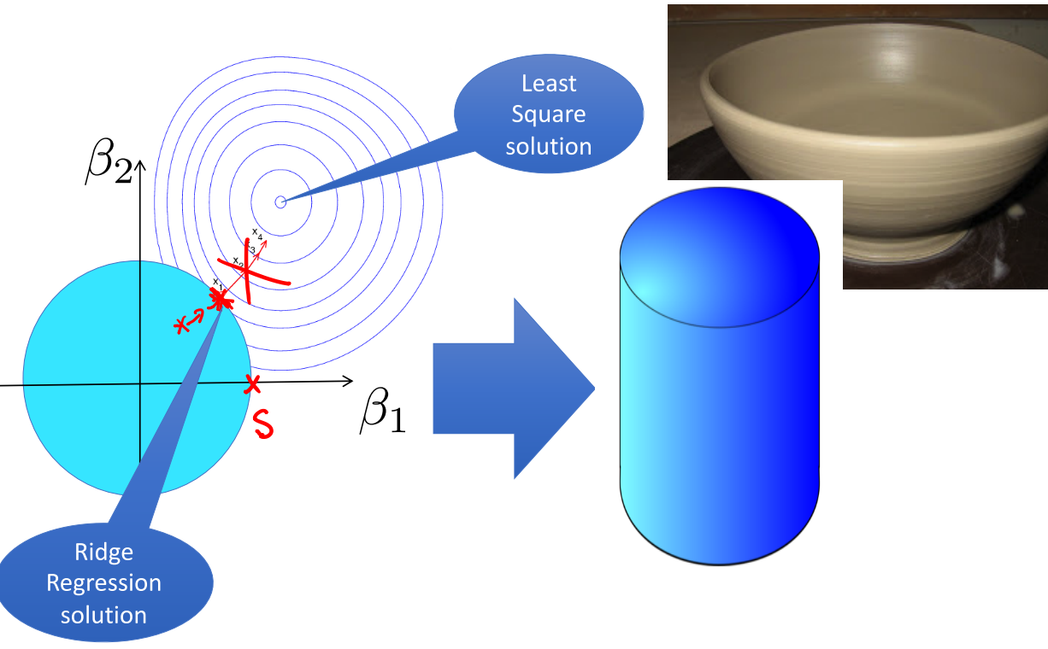
Ridge Regression: Squared Loss+L2
Influence of Regularization Parameter

Slide 27
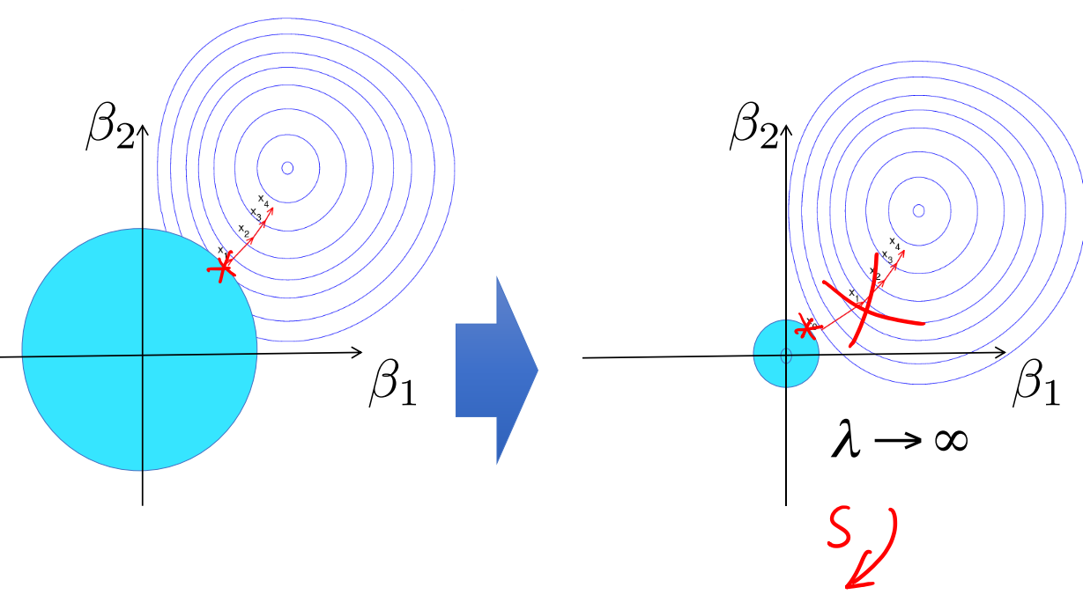
Ridge Regression: Squared Loss+L2
Influence of Regularization Parameter

Slide 28
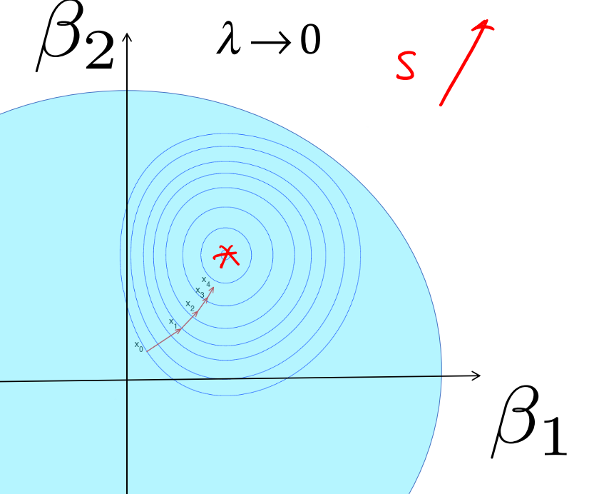
Ridge Regression: Squared Loss+L2
Influence of Regularization Parameter

Slide 30
Today
Review: (Ordinary) Least squares: squared loss (Normal Equation
Ridge regression: squared loss with L2 regularization
Lasso regression: squared loss with L1 regularization
Elastic regression: squared loss with L1 AND L2 regularization
How to Choose Regularization Parameter

Slide 31
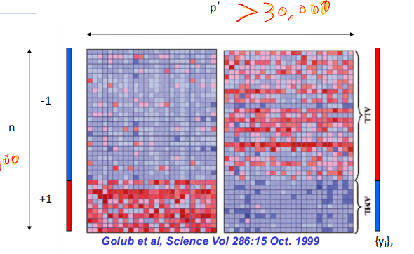
Lasso: Implicit Feature Selection
e.g., Leukemia Diagnosis
p’ > 30,000
But only a few features make sense!
Feature selection
n
<100

Slide 32
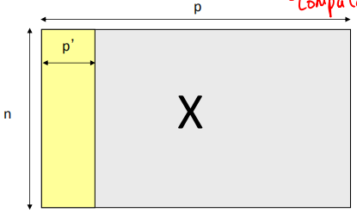
Lasso: Implicit Feature Selection
p -> p’
easy to understand
Computational efficient
Feature selection
Lasso is used for this

Slide 33
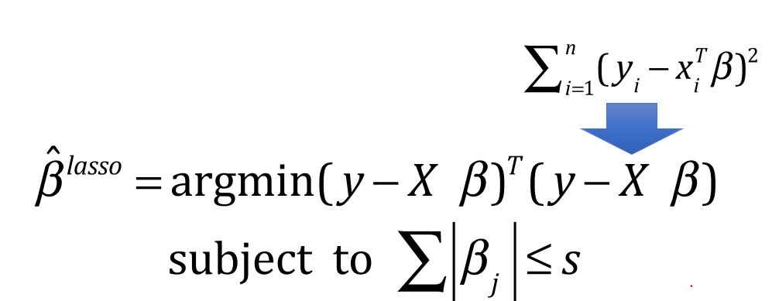
Lasso (least absolute shrinkage and selection operator) / Squared Loss+L1
The lasso is a shrinkage method like ridge, but acts in a nonlinear manner on the outcome y.
The lasso is defined by

Slide 34
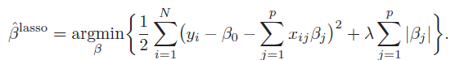
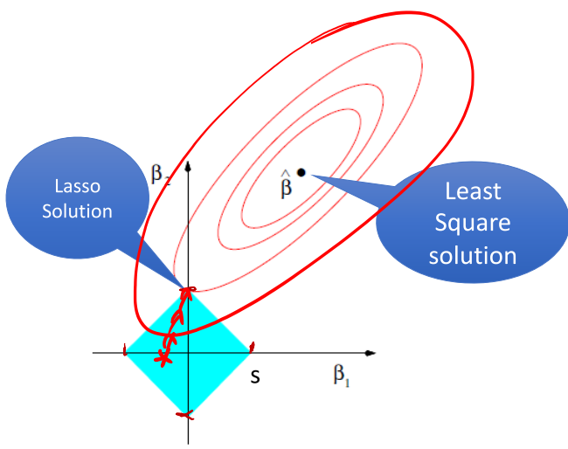
Lasso / Squared Loss+L1
Suppose in 2 dimension
β = (β1 , β2)
| β1 |+| β2 |=const
| β1 |+|- β2 |=const
| -β1 |+| β2 |=const
| -β1 |+| -β2 |=const

Slide 35
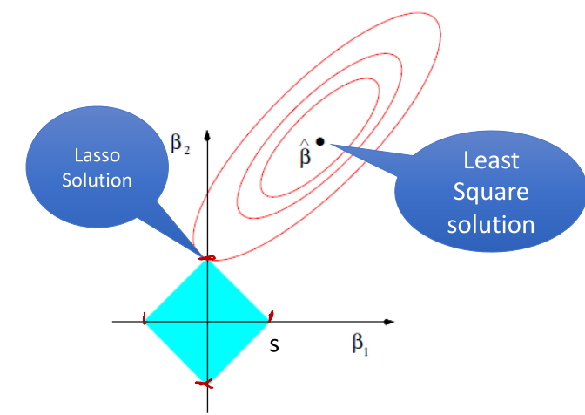
Lasso / Squared Loss+L1
In the Figure, the solution has eliminated the role of x2, leading to sparsity

Slide 36

Lasso & Ridge

Slide 37

Lasso
Notice that ridge penalty $\sum{β_{j}^{2}}$ is replaced by $\sum{|β_{j}|}$
Due to the nature of the constraint, if tuning parameter is chosen small enough, the lasso will set some coefficients exactly to zero.

Slide 38
Today
Review: (Ordinary) Least squares: squared loss (Normal Equation
Ridge regression: squared loss with L2 regularization
Lasso regression: squared loss with L1 regularization
Elastic regression: squared loss with L1 and L2 regularization
How to Choose Regularization Parameter

Slide 39
Lasso when p>n
Prediction accuracy and model interpretation are two important aspects of regression models.
LASSO does shrinkage and variable selection simultaneously for better prediction and model interpretation.
Disadvantage:
In p>n case, lasso selects at most n variable before it saturates
If there is a group of variables among which the pairwise correlations are very high, then lasso select one from the group

Slide 40
(3) Hybrid of Ridge and Lasso : Elastic Net regularization
L1 part of the penalty generates a sparse model
L2 part of the penalty (extra):
Remove the limitation of the number of selected variables
Encouraging group effect
Stabilize the L1 regularization path

Slide 41

Naïve elastic net
For any non negative fixed λ1 and λ2, naive elastic net criterion:
The naive elastic net estimator is the minimizer of above equation:

Slide 42

Naïve elastic net
The naive elastic net estimator is the minimizer of above equation:
Equivalently:

Slide 43

Geometry of elastic net

Slide 44


More Ways for Measuring Regression Predictions: Correlation Coefficient
Pearson correlation coefficient
For regression: $r({\vec{y}}_{predicted},{\vec{y}}_{known})$
Measuring the linear correlation between two sequences, x and y,
giving a value between +1 and −1 inclusive, where 1 is total positive correlation, 0 is no correlation, and −1 is total negative correlation.

Slide 45
Advantage of Elastic net (Extra)
Naive Elastic set can be converted to lasso with augmented data form
In the augmented formulation,
sample size n+p and X* has rank p
→ can potentially select all the predictors
Naïve elastic net can perform automatic variable selection like lasso

Slide 46

Summary: Regularized multivariate linear regression
Model: $\hat{Y}={\hat{β}}_{0}+{\hat{β}}_{1}x_{1}$+…+${\hat{β}}_{0}x_{p}$
LR estimation:
$$argmin\sum{{(Y−\hat{Y})}^{2}}$$
LASSO estimation:
$$argmin\sum_{i=1}^{n}{{(Y−\hat{Y})}^{2}}+λ\sum_{i=1}^{p}{|β_{j}|}$$
Ridge regression estimation:
$$argmin\sum_{i=1}^{n}{{(Y−\hat{Y})}^{2}}+λ\sum_{i=1}^{p}{{β_{j}}^{2}}$$
Error on data +
Regularization

Slide 47

Regularized multivariate linear regression

Slide 48



More: A family of shrinkage estimators
For q >=0, contours of constant value of are shown for the case of two inputs.

Slide 49

More: A family of shrinkage estimators
norms visualized
all norms penalize larger weights
q < 2 tends to create sparse (i.e. lots of 0 weights)
q > 2 tends to push for similar weights

Slide 50
We aim to make the learned model
• Generalize Well
• Computational Scalable and Efficient
• Robust / Trustworthy / Interpretable
• Especially for some domains, this is about trust!

Slide 51
Today
Review: (Ordinary) Least squares: squared loss (Normal Equation
Ridge regression: squared loss with L2 regularization
Lasso regression: squared loss with L1 regularization
Elastic regression: squared loss with L1 AND L2 regularization
How to Choose Regularization Parameter

Slide 52
Regularized multivariate linear regression

Slide 53

Common regularizers
$$\sum_{j}{|β_{j}|}$$
$$\sum_{j}{{β_{j}}^{2}}$$
Generally, we don’t want huge weights
If weights are large, a small change in a feature can result in a large change in the prediction
Might also prefer weights of 0 for features that aren’t useful
L1: Sum of weights will penalize small values more:
L2: Squared weights penalizes large values more:

Slide 54
Model Selection & Generalization
Generalisation: learn function / hypothesis from past data in order to “explain”, “predict”, “model” or “control” new data examples
Underfitting: when model is too simple, both training and test errors are large
Overfitting: when model is too complex and test errors are large although training errors are small.
After learning knowledge, model tends to learn “noise”

Slide 55

Issue: Overfitting and underfitting
underfitting
Looks good
overfitting

Slide 56

Overfitting: Handled by Regularization
A regularizer is an additional criteria to the loss function to make sure that we don’t overfit
It’s called a regularizer since it tries to keep the parameters more normal/regular
It is a bias on the model forces the learning to prefer certain types of weights over others, e.g.,

Slide 57

Why and How to Select λ?
Generalization ability
→ k-folds CV to decide
Control the bias and Variance of the model (details in future lectures)
$$\sum_{j}{|β_{j}|}$$
$$\sum_{j}{{β_{j}}^{2}}$$
L1: Sum of weights will penalize small values more:
L2: Squared weights penalizes large values more:

Slide 58




WHY and How to Select λ?
Regularization path of a Ridge Regression

Slide 59


WHY and How to Select λ?
Regularization path of a Lasso Regression

Slide 60
Today Recap
Review: (Ordinary) Least squares: squared loss (Normal Equation
Ridge regression: squared loss with L2 regularization
Lasso regression: squared loss with L1 regularization
Elastic regression: squared loss with L1 AND L2 regularization
How to Choose Regularization Parameter

Slide 61



Regression (supervised)
Four ways to train / perform optimization for linear regression models
Normal Equation
Gradient Descent (GD)
Stochastic GD
Newton’s method
Supervised regression models
Linear regression (LR)
LR with non-linear basis functions
Locally weighted LR
LR with Regularizations
Variations of $argminL(θ)$
Variations of$f(x)$
Variations of $f(θ)$

Slide 62
References
https://qiyanjun.github.io/2019f-UVA-CS6316-MachineLearning/

Slide 63
Thanks for listening

